Slide 1
Regression Analysis
Multiple Linear Regression
Nicoleta Serban, Ph.D.
Professor
School of Industrial and Systems Engineering
Ranking States by SAT Performance: Exploratory Analysis

Slide 2

About This Lesson

Slide 3
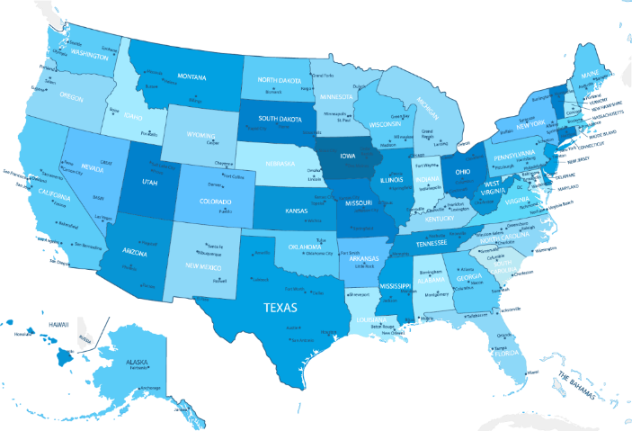
Linear Regression: Example 2
Controlling Factors:
X₁ = % of total eligible students in the state who took the exam
X₆ = Median percentile of ranking of test takers within their secondary school classes
Explanatory Factors:
X₂ = Median income of families of test takers, in hundreds of dollars
X₃ = Average number of years that test takers had in social sciences, natural sciences, and humanities
X₄ = % of test takers who attended public schools
X₅ = State expenditure on secondary schools, in hundreds of dollars per student

Slide 4
Ranking States by SAT Performance
Which variables are associated with state average SAT scores?
After accounting for selection biases, how do the states rank?
Which states perform best for the amount of money they spend?

Slide 5
Response & Predicting Variables
Response Variable:
  sat State average SAT score (verbal and quantitative combined)
Predicting Variables:
  takers % of eligible students (high school seniors) in state who took the exam
  rank Median percentile of ranking of test takers within their secondary school classes
  income Median income of families of test takers, in hundreds of dollars
  years Average number of years that test takers had in social sciences, natural sciences, and humanities
  public % of test takers who attended public schools
  expend State expenditure on secondary schools, in hundreds of dollars per student

Slide 6
Controlling Variables
Selection Bias:
The states with high average SAT scores had low percentages of takers.
Those taking the test tend to be in the higher median percentiles of rankings of test takers within their secondary school classes.
Controlling Factors:
  takers % of eligible students (high school seniors) in state who took the exam
  rank Median percentile of ranking of test takers within their secondary school classes

Slide 7
Read the Data in R
## Read the data using the 'read.table()' R command because it is an ASCII file
data = read.table("SATData.txt", header = TRUE)
## Check data to make sure correctly read in R
data[1:4,]
## Check dimensionality of the data file
dim(data)
[1] 50 8
## Attach data to automatically recognize the columns in the data as individual vectors
attach(data)
 | State | sat | takers | income | years | public | expend | rank
1 | Iowa | 1088 | 3 | 326 | 16.79 | 87.8 | 25.60 | 89.7
2 | SouthDakota | 1075 | 2 | 264 | 16.07 | 86.2 | 19.95 | 90.6
3 | NorthDakota | 1068 | 3 | 317 | 16.57 | 88.3 | 20.62 | 89.8
4 | Kansas | 1045 | 5 | 338 | 16.30 | 83.9 | 27.14 | 86.3
The data consist of 50 rows, each corresponding to a U.S. state.

Slide 8
Exploratory Data Analysis in R
## Evaluate the shape of the distribution of each predicting variable and of the response variable
par(mfrow = c(2, 4))
hist(sat, main = "Histogram of SAT Scores", xlab = "Mean SAT Score", col = 1)
hist(takers, main = "Histogram of Takers", xlab = "Percentage of Students Tested", col = 2)
hist(income, main = "Histogram of Income", xlab = "Mean Household Income ($100s)", col = 3)
hist(years, main = "Histogram of Years", xlab = "Mean Years of Sciences and Humanities", col = 4)
hist(public, main = "Public Schools Percentage", xlab = "Percentage of Students in Public Schools", col = 5)
hist(expend, main = "Histogram of Expenditures", xlab = "Schooling Expenditures/Student ($100s)", col = 6)
hist(rank, main = "Histogram of Class Rank", xlab = "Median Class Ranking Percentile", col = 7)
## Evaluate the scatter plot matrix of the data, ignoring the first column
par(mfrow = c(1, 1))
plot(data[,-1])
## Explore the correlation coefficients
round(cor(data[,-1]), 2)

Slide 9
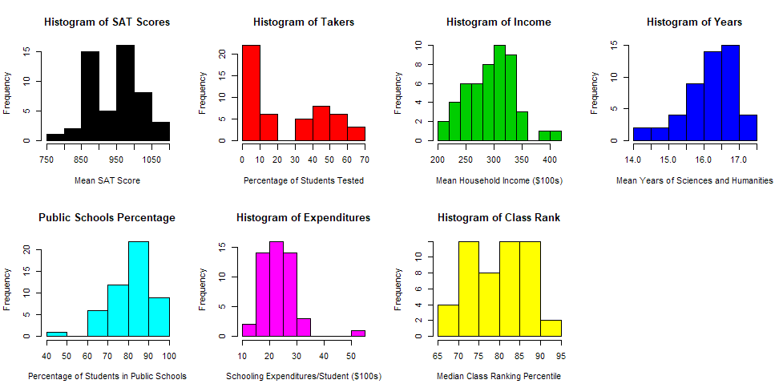
Exploratory Data Analysis in R

Slide 10
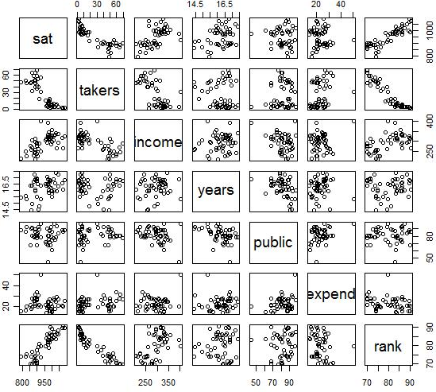
Exploratory Data Analysis in R (Cont’d)
sat takers income years public expend rank
sat 1.00 -0.86 0.58 0.33 -0.08 -0.06 0.88
takers -0.86 1.00 -0.66 -0.10 0.12 0.28 -0.94
income 0.58 -0.66 1.00 0.13 -0.31 0.13 0.53
years 0.33 -0.10 0.13 1.00 -0.42 0.06 0.07
public -0.08 0.12 -0.31 -0.42 1.00 0.28 0.05
expend -0.06 0.28 0.13 0.06 0.28 1.00 -0.26
rank 0.88 -0.94 0.53 0.07 0.05 -0.26 1.00

Slide 11

Summary

